Slide 1


Applications of Additive
Manufacturing in Space Construction
Feasibility, Sustainability, and Cost-Effectiveness Effectiveness
Submitted by:
Group 9 –
Priyanshu Singh (2022MEB1332)
Aryan Daga (2022MEB1300)
Guided by: Dr. Prabir Sarkar
Institution: Indian Institute of Technology, Ropar

Slide 2



Presentation Overview
1
Purpose
2
Key Topics
Demonstrate how AM can be applied in space for sustainable and efficient construction.
Current challenges, proposed innovations, sustainability impacts, and future directions.
3
Goal
Present findings and recommendations for advancing AM in extraterrestrial environments.

Slide 3
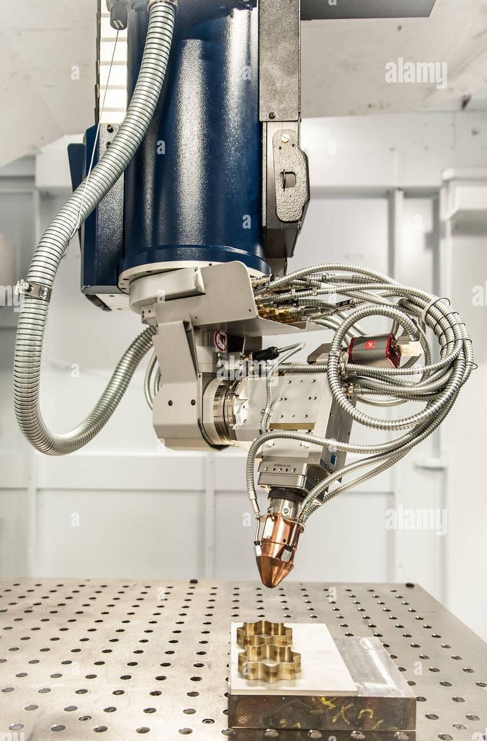



Introduction to Additive Manufacturing in Space
Definition and Process
Additive Manufacturing (AM), also known as 3D printing, is a technique that constructs objects layer by layer from digital models, significantly reducing material waste compared to traditional manufacturing. This technology enables customization and allows for complex designs that are otherwise difficult or impossible to achieve with conventional manufacturing techniques.
Current Applications
AM is extensively used in sectors like aerospace for creating lightweight parts, automotive
rapid prototyping, and medical for customized implants. These applications highlight AM’s flexibility, precision, and ability to meet specific structural and functional requirements.
Relevance in Space
For space exploration, AM offers the potential to construct habitats, tools, and infrastructure directly on extraterrestrial surfaces. By utilizing in-situ resources like lunar or Martian regolith, AM can minimize dependency on Earth for building materials, opening new possibilities for long-term human presence on the Moon and Mars.

Slide 4
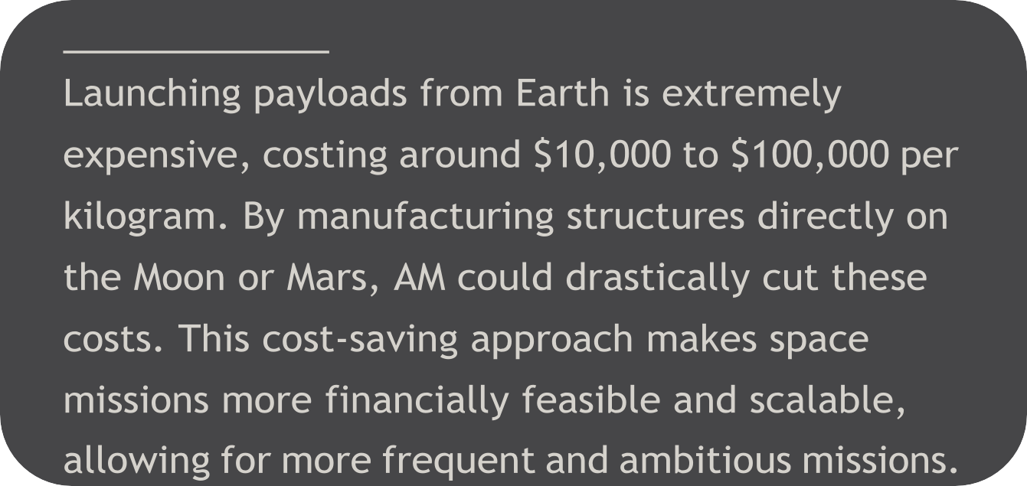













hy AM is Crucial for Space Missions
Cost Reduction
Environmental Adaptability
Reduced Earth Dependence
Fact

Slide 5
Challenges in Extraterrestrial Construction
Transport Limitations
Extreme Environmental Conditions
Autonomous Operation Requirements
High costs and limited payload capacity make transporting materials from Earth impractical for large-scale space construction.
The Moon’s temperature ranges from -173°C to 127°C, while Mars faces severe dust storms and lower atmospheric pressure, requiring materials that can withstand these extremes.
Communication delays of up to 24 minutes to Mars make real-time remote control infeasible; autonomous systems are essential for construction.

Slide 6
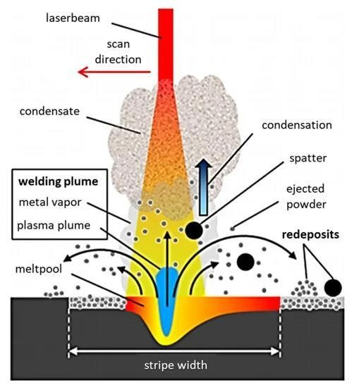
AM Techniques in Space
1
Powder Bed Fusion (PBF)
Uses electron/laser beams for layer precision in low-gravity environments.
2
Material Extrusion
Deposits regolith-binder mixtures for foundational and large structures.
3
Microwave-Assisted Sintering
Suitable for creating durable, sintered structures with low energy.
4
Environmental Adaptations
PBF's reduced oxidation need in lunar vacuum.

Slide 7
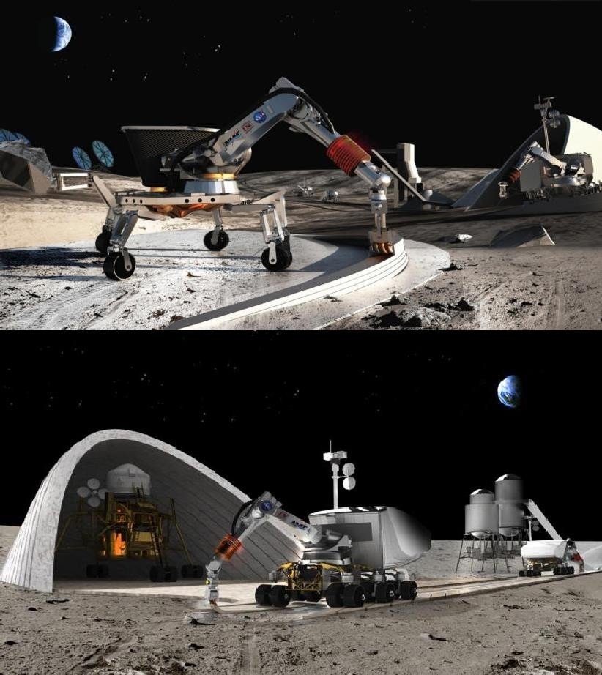

Current Research and Innovations
NASA's 3D-Printed Habitat Challenge
Habitat prototypes made from lunar and Martian regolith simulants.
ESA Projects
Focus on robotic construction and lunar regolith research for structural applications.
Private Sector Advances
ICON's Project Olympus aims to develop autonomous 3D printing for the Moon.
Limitations
Differences between regolith simulants and actual extraterrestrial soil remain a challenge.
Fact: ICON's regolith-based structures achieve compressive strength comparable to concrete (~25-40 MPa).

Slide 8

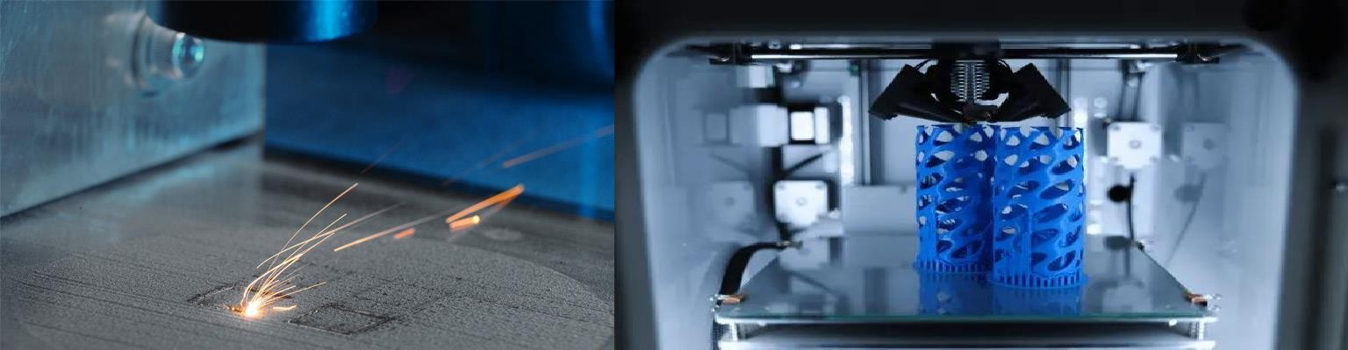
Our Hybrid AM Approach for Space
Integrates Powder Bed Fusion, Material Extrusion, and
Structural Benefits
Increased strength, faster construction times, and layered durability.
Material Efficiency
Allows for optimized regolith use, minimizing waste.

Slide 9
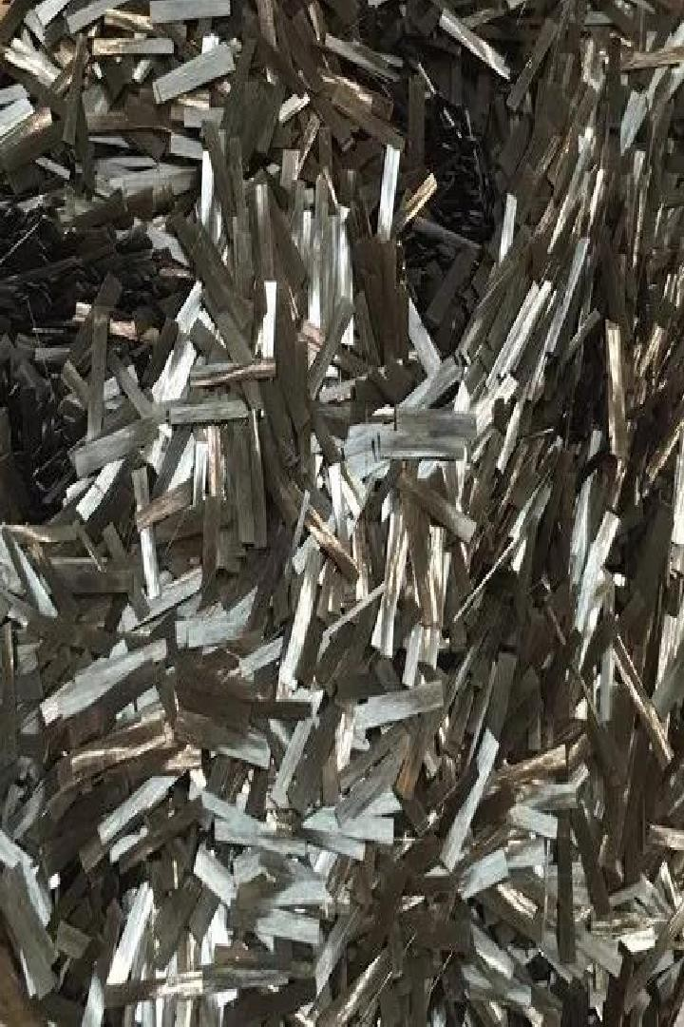
Introducing Basalt Fiber Reinforcement
1
Material Source
2
Improved Strength and Insulation
Enhanced tensile strength and thermal resistance.
Basalt fibers derived from lunar and Martian volcanic rocks.
3
Environmental Benefits
4
Additional Durability
Essential for longevity in high-radiation environments.
Resists radiation and abrasive regolith particles.
Fact: Basalt fiber-reinforced structures withstand up to 40% more stress than unreinforced regolith.

Slide 10
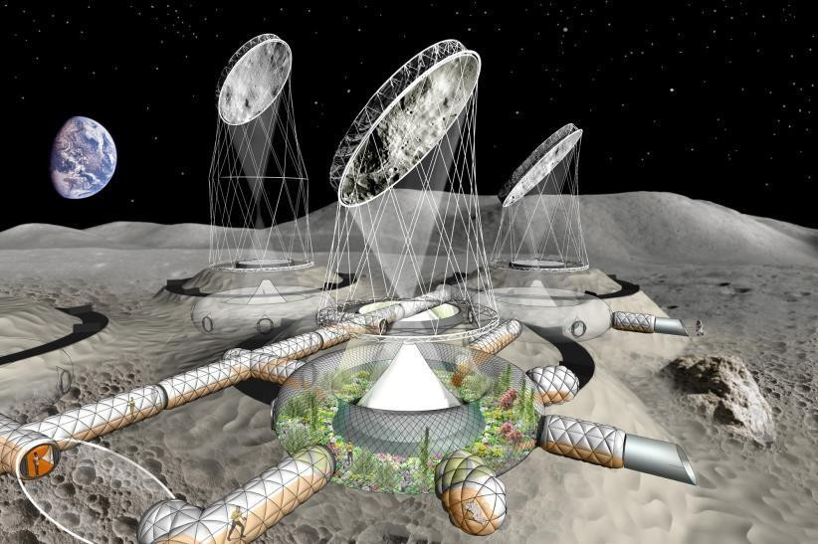
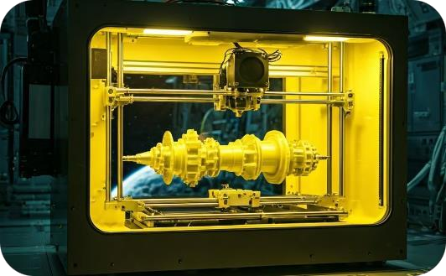
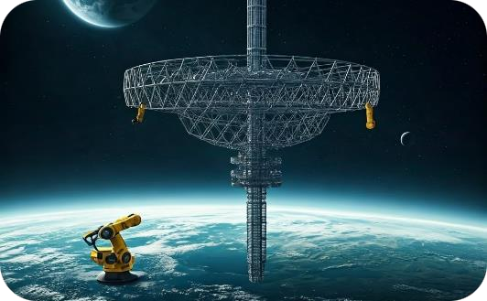
Future of Additive Manufacturing in Space
Expanded Habitats
In-Space Manufacturing
Mega-Structures
Large-scale 3D-printed cities on Mars and the Moon, supporting growing populations of space settlers.
On-demand production of spare parts and equipment, reducing reliance on Earth-based supply chains.
Construction of enormous space structures like space elevators and orbital habitats using advanced AM techniques.

Slide 11
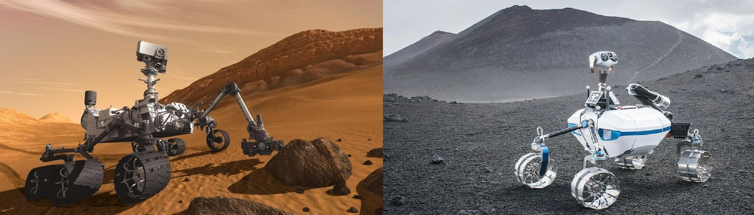
Multi-Robot System for Autonomous AM
1
AI-Driven
2
Collaborative Robots
Real-time adaptability to environmental changes and material variations.
Team-based approach to increase efficiency in large-scale construction.
3
Monitoring
4
Self-Repairing Capability
Sensors to track environmental factors, such as radiation and dust, and adjust robot actions.
Minor repairs made autonomously to prevent operational downtime.

Slide 12

Selecting and Processing Local Materials
Lunar Regolith
Martian Soil
Advanced Additives
Rich in silicates and oxides; suited for radiation shielding and structural stability.
Requires perchlorate treatment but effective for extrusion-based AM.
Polymer and basalt fibers improve flexibility and environmental resistance.
Fact: Regolith can achieve compressive strengths comparable to terrestrial concrete when sintered.

Slide 13
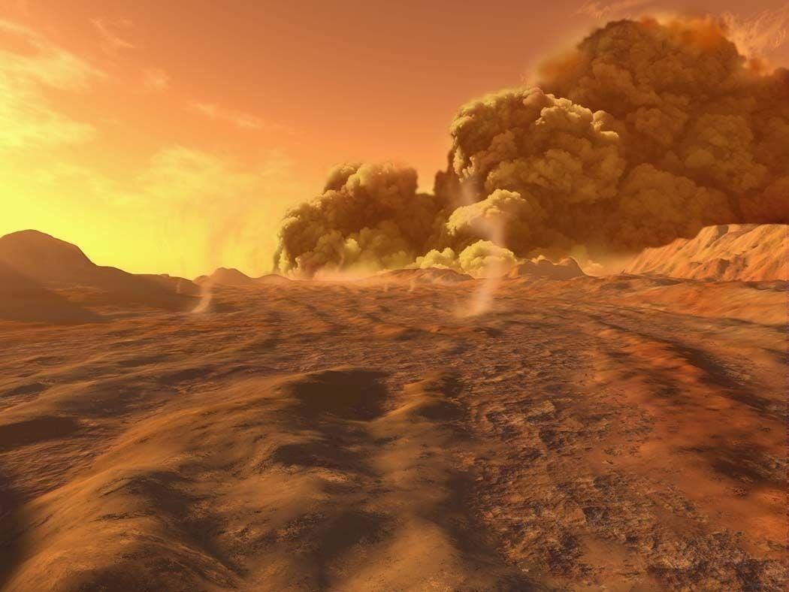
Managing Environmental Challenges
1
Dust Control
2
Temperature Regulation Regulation
Electrostatic dust repellents prevent abrasion on equipment.
Insulated AM chambers maintain stable temperatures for layer bonding.
3
Radiation Protection
4
Abrasion Resistance
Regolith's natural radiation resistance is enhanced by added basalt fibers.
Specialized coatings protect AM equipment from regolith wear.

Slide 14


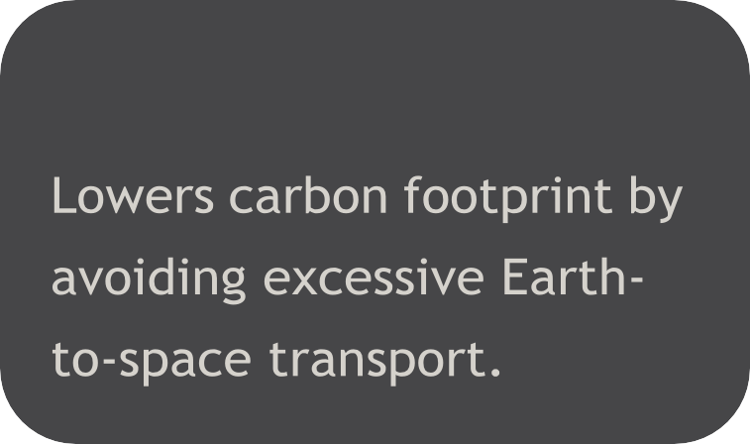


Sustainability and Cost-Reduction Benefits
Cost Savings
Environmental Impact
Circular Resource Use
Long-Term Viability
fibers create a sustainable,

Slide 15
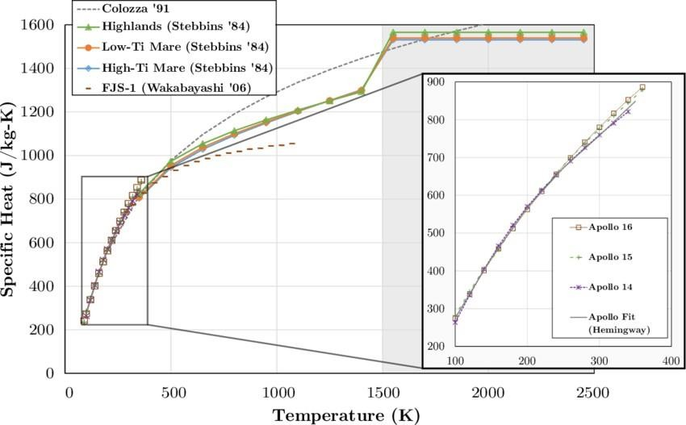
Simulation Studies and Predictive Models
1
Finite Element Analysis (FEA)
Validates regolith structures under load and temperature extremes.
2
Lifecycle Analysis (LCA)
Assess sustainability and efficiency improvements over conventional methods.
3
Thermal Modeling
Shows that layered regolith effectively insulates against temperature shifts.
4
Dust Storm Testing
Models for Martian conditions show durability against prolonged dust exposure.
Reference: Research Gate

Slide 16

Case Studies on AM Viability Viability
1
NASA Challenge Results
2
ESA Research
Prototypes achieve compressive strengths
>40 MPa.
Sintered lunar regolith with tensile properties close to concrete.
3
Commercial Trials
ICON structures survive temperature cycling and dust simulations.
4
Real-World Testing
AM-built walls withstand simulated Mars dust storms for weeks.

Slide 17
Summary of Findings and Benefits
Strength
Radiation Protection
Cost Efficiency
Regolith-based AM structures match terrestrial materials in durability.
Multi-layer regolith and basalt fibers provide effective shielding.
Significant savings in payload costs for lunar and Martian missions.
Environmental Sustainability: ISRU-based AM aligns with space exploration's sustainability goals.
Fact: Estimated up to $100 million savings per mission from reduced transport costs.

Slide 18

Advancing AM for Space Construction
Material Standardization
Ensuring a standardized method for processing regolith, which varies in composition between the Moon and Mars, is crucial for consistent and
reliable AM structures. This includes developing techniques for testing regolith’s compatibility with binders and reinforcement fibers in situ, ensuring that materials meet strength and safety benchmarks across different environments.
Robotic Enhancement
To achieve fully autonomous AM on lunar and Martian surfaces, future research should focus on enhancing robotic adaptability.
This involves refining AI algorithms to better respond to unpredictable conditions, such as dust storms or material variations, which could interfere with precision. Additionally, advanced sensor integration for real-time environmental monitoring will allow robots to adjust AM parameters, improving resilience and efficiency.
Environmental Validation
Testing AM methods on Earth using simulated lunar and Martian environments is an ongoing priority. However, conducting experiments directly on the
Moon or Mars (through exploratory missions or deployed test platforms) will offer more accurate data on environmental stressors, such as extreme temperatures and low-gravity effects, and validate durability for long-term habitats.
Multi-Nation Collaboration
As space exploration expands, increased collaboration between international space agencies (e.g., NASA, ESA, ISRO, and CNSA) is essential. Joint
research initiatives and shared funding for large-scale testing of AM technologies can accelerate advancements, creating a framework for scalable space construction projects. This approach also leverages diverse expertise and fosters innovation by pooling resources for common goals.

Slide 19
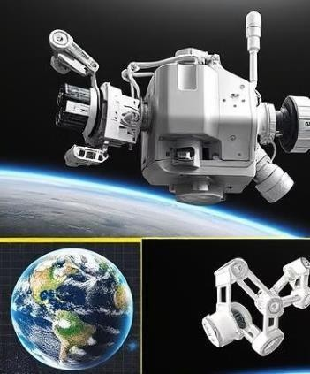
Conclusion and References
Conclusion
1
AM provides a practical solution for sustainable extraterrestrial habitats.
2
Hybrid AM methods and autonomous robots enable in-situ construction, reducing Earth dependency.
3
Collaboration
Ongoing international collaborations are essential for rapid advancements.
References
NASA 3D-Printed Habitat Challenge. (2018).
European Space Agency. (2020). Lunar Regolith Research.
ICON Project Olympus Overview. (2021).
Khoshnevis, B. (2014). Large-Scale Additive Manufacturing.
Chesnais, F., & Defer, P. (2020). Robotics in AM for Space Exploration.

